Slide 1

Job role
Equity Data Scientist

Slide 2
Why Equity Data Scientist?
decisions
analyze market trends
reduce losses
increase profits
As I have 11 years of experience in capital market this role as Equity Data Scientist will help me in analyzing trading data of financial market which will give insights for decision making, analyzing market trends and designing machine learning models to predict stock prices.
According to the US Bureau of Labor Statistics, the number of employment required Data Science skills is predicted to expand by 27.9% by 2026, making now the best time to start a career in Data Science.

Slide 3
Responsibility as Equity Data Scientist
Equity Data Scientist
Statistical Research
Domain Expertise
(Equity)
Mathematics
Machine Learning
Data Processing
Designing workflow to analyze external and internal data of financial market
Generating investment insights from designed workflow
Developing machine learning and artificial intelligence-based model to find actionable insights for investment teams
Evaluating, validating and testing models based on statistical significance
Visualization of insights and analysis to share among large numbers of business users

Slide 4
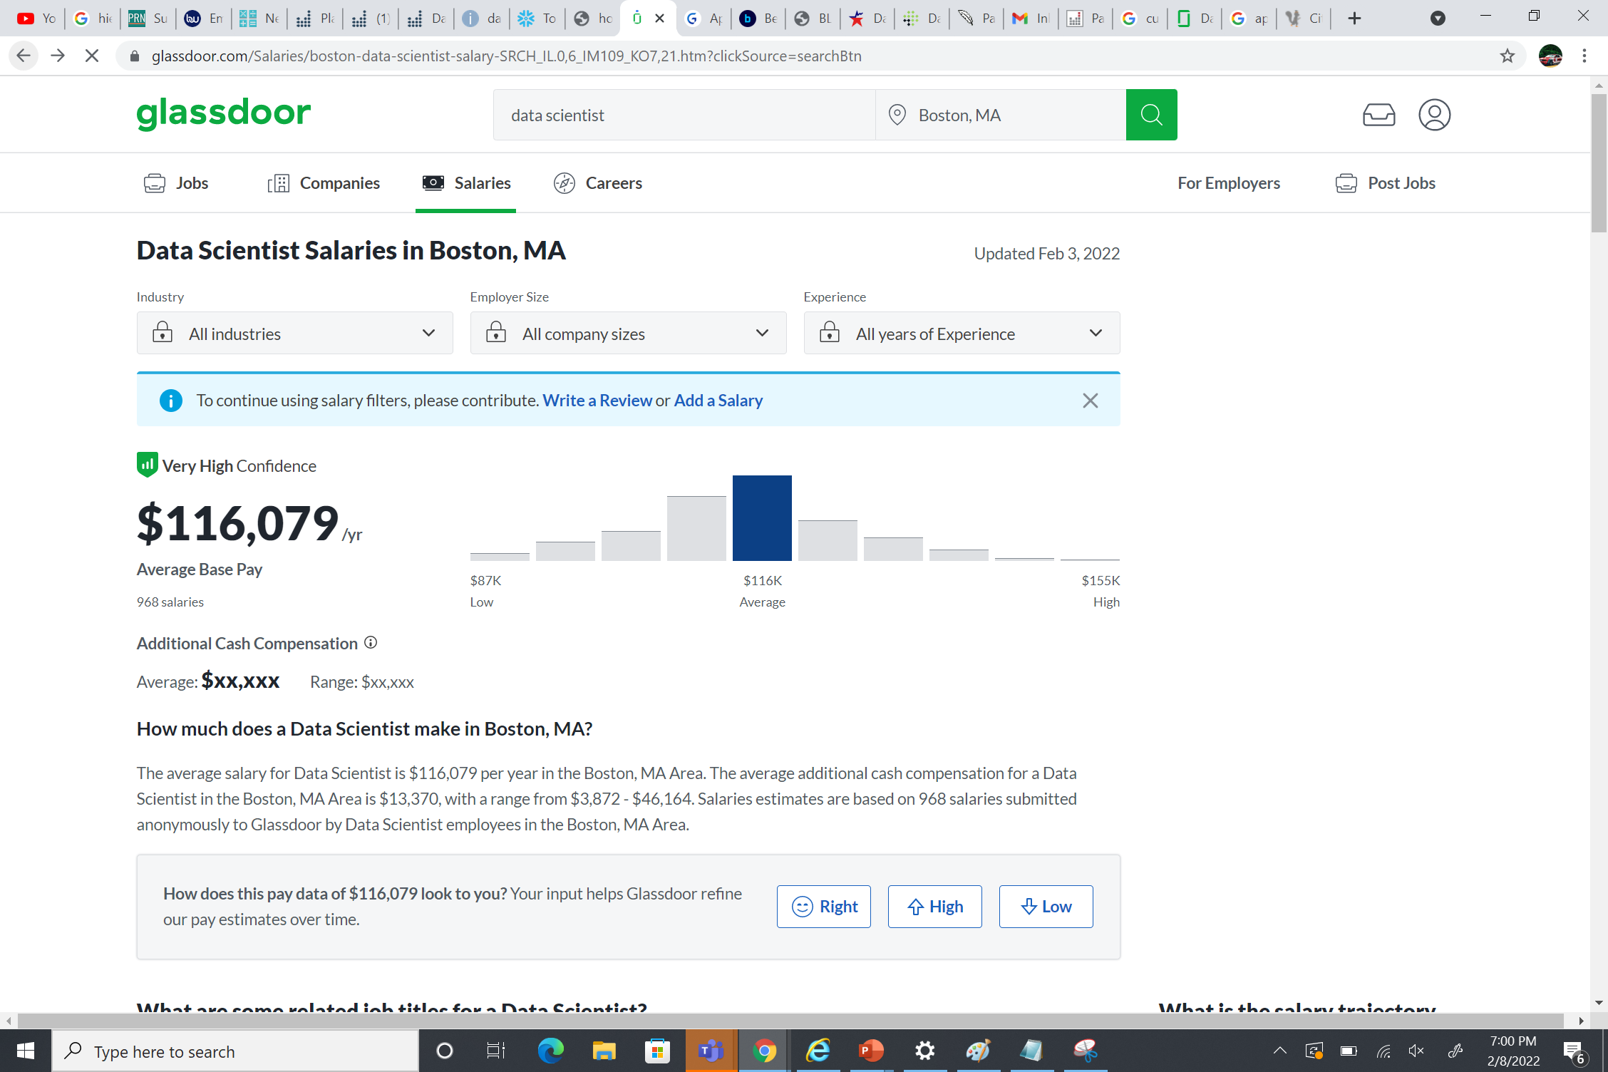
Job Prediction
Nowadays, data science is in high demand. A data scientist job is the fastest-growing job.
According to LinkedIn, this industry is expected to employ 11.5 million people by 2026.
An individual data scientist earns an average of $116,000 a year, according to Glassdoor.
AI consulting also demands the use of data scientists.

Slide 5
Required Skill Set
R
MATLAB
SQL
ML
Python
Data Visualization
Natural Processing Languages
Tableau

Slide 6
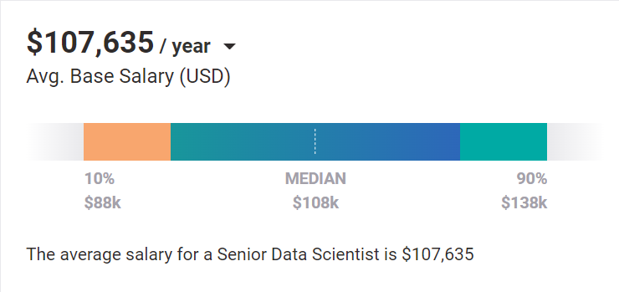
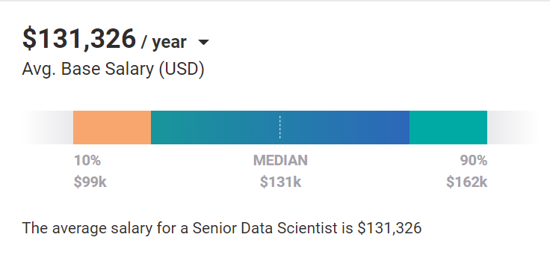
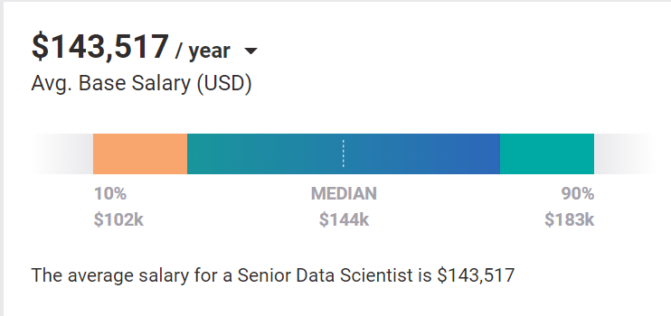
Pay Analysis
Entry level
Machine Learning, Big Data Analytics, Python, and R skills are linked to average salary.
Statistical Analysis is one of the skills that pays less than market rate.
Mid-Career
R
Data Analytics
Python
Machine Learning
Statistical Analysis
Experienced

Slide 7
[1] https://www.analyticsinsight.net/data-scientists-will-be-the-most-in-demand-profession-in-the-next-5-years-here-is-why/
[2]https://www.payscale.com/research/US/Job=Senior_Data_Scientist/Salary/c8a36a27/Late-Career
[3] https://www.glassdoor.com/Salaries/boston-data-scientist-salary-SRCH_IL.0,6_IM109_KO7,21.htm?clickSource=searchBtn
[4]https://www.payscale.com/mypayscale.aspx?tab=personal&view=reports&surveyId=9c99e794-ecd7-427e-84e8-117f792a6ff8
[5]https://www.linkedin.com/jobs/view/equity-data-scientist-at-morgan-stanley-2838559501/?utm_campaign=google_jobs_apply&utm_source=google_jobs_apply&utm_medium=organic
References

